Slide 1

DESIGNING A SNAKE GAME USING REINFORCEMENT LEARNING TECHNIQUES
Presented by :
-Venkata Uday Kumar Edara
-Gowtham Chebrolu

Slide 2
Project Objective:
Designing a Snake game using Reinforcement Learning techniques:
1. Deep Q Network (DQN)
2. Dueling DQN
3. Asynchronous Advantage Actor-Critic (A3C)
Compare performance metrics (score, efficiency, stability).

Slide 3
What is Reinforcement Learning (RL)?
Reinforcement Learning (RL) is a machine learning approach where an agent learns to make decisions by interacting with an environment to maximize cumulative reward.
Key Components:
Agent – The learner/decision maker (e.g., the Snake)
Environment – The world the agent interacts with (e.g., game grid)
State (s) – Current situation returned by the environment
Action (a) – Choices available to the agent (e.g., turn left/right)
Reward (r) – Feedback from the environment (e.g., +1 for eating food)

Slide 4
Snake Game Environment:
Game Setup:
Classic grid-based board
Snake moves, grows by eating food
Game ends if the snake collides with itself or walls
State Representation:
Snake’s current position and direction
Food location
Proximity to obstacles (walls or body)

Slide 5
Implementation Framework:
Libraries Used:
PyTorch – For building and training neural networks
Pygame – For game development and rendering
NumPy – For numerical operations and data handling
Architecture Overview:
game.py– Implements the game environment, snake behavior, and collision detection
agent.py– Contains the reinforcement learning algorithm and training workflow
model.py– Defines the neural network used to approximate action-values
snake_human_game.py– Allows manual control of the snake for testing and comparison

Slide 6
Training & Evaluation Metrics:
Average Score – Measures consistency across episodes
Maximum Score – Indicates peak performance
Training Time – Evaluates efficiency of each algorithm
Convergence Speed – How quickly the model stabilizes
Stability – Variance in scores over time
Visualization:
Plot: Episodes vs. Score
Compare performance trends across DQN, A3C, and Dueling DQN.

Slide 7
Deep Q-Network (DQN):
Methodology:
Combines Q-Learning with deep neural networks to handle high-dimensional state spaces.
Uses a replay buffer to store experiences and reduce correlation between samples.
Employs a target network for stable training.
Key Features:
Off-policy algorithm (learns from past experiences).
Uses ε-greedy exploration for balancing exploration-exploitation.
Suitable for discrete action spaces (e.g., Atari games).
Challenges:
High sample complexity.
Not suitable for continuous action spaces.

Slide 8
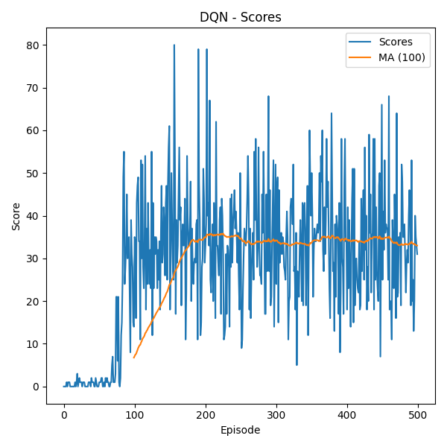
Performance Metrics for DQN:
Metric | Value
Max Score | 78
Average Score | 29.2
Training Time (min) | 33.32 mins
Convergence Episode | 234
Average Episode Length | 654.17 steps
Score Standard Deviation | 17.65

Slide 9
Dueling DQN
Methodology:
Combines Q-Learning with deep neural networks to handle high-dimensional state spaces.
Uses a replay buffer to store experiences and reduce correlation between samples.
Employs a target network for stable training.
Key Features:
Reduces overoptimistic Q-values by separating action selection and evaluation.
Uses the same architecture as DQN (easy to implement).
Compatible with discrete action spaces (e.g., Snake game).
Challenges:
Still requires large replay buffers (sample inefficiency).
Limited to discrete actions like DQN

Slide 10
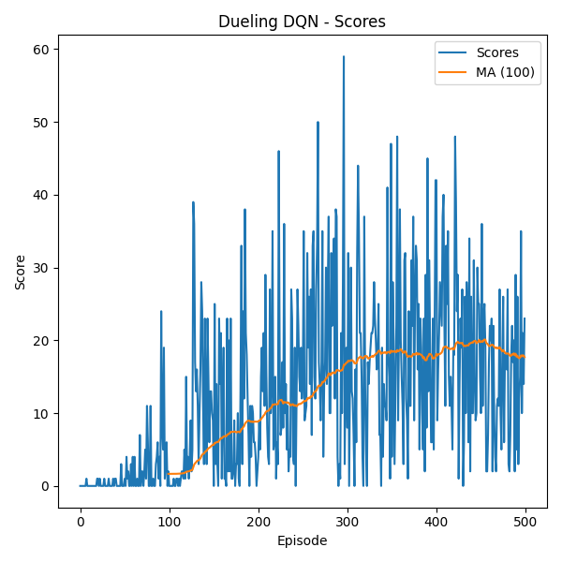
Performance Metrics for Deuling DQN:
Metric | Value
Max Score | 59
Average Score | 12.586
Training Time (min) | 41.88 mins
Convergence Episode | 330
Average Episode Length | 493.92 steps
Score Standard Deviation | 11.92

Slide 11
A3C: Asynchronous Advantage Actor-Critic
Methodology:
An on-policy RL algorithm combining Policy Gradient (Actor) and Value Function (Critic).
Uses parallel agents (asynchronous updates) for faster, more stable training.
Estimates the advantage function (A = Q - V) to reduce variance.
Key Features:
Parallel training → Faster convergence.
Better sample efficiency than pure Policy Gradients.
Works in both discrete & continuous action spaces.
Challenges:
Hyperparameter-sensitive.
Requires careful tuning for stability.

Slide 12
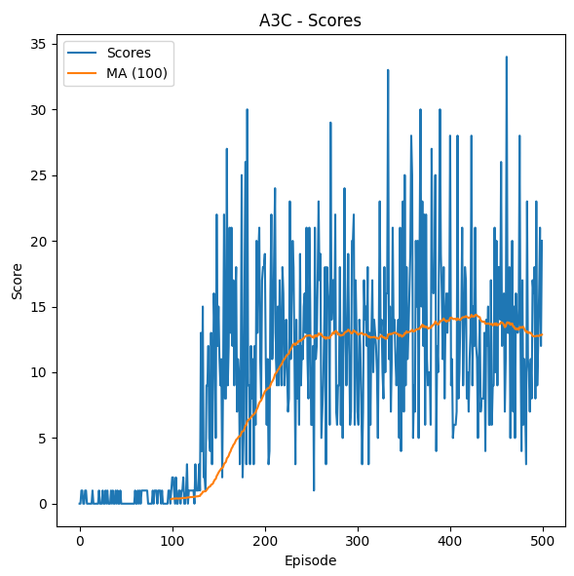
Performance Metrics for A3C:
Metric | Value
Max Score | 35
Average Score | 9.702
Training Time (min) | 17.28 minutes
Convergence Episode | 208
Average Episode Length | 275.32 steps
Score Standard Deviation | 7.6902

Slide 13
Algorithm Comparisons
Algorithm | Max Score | Average Score | Training Time (min) | Convergence Episode | Average Episode Length | Score Std Dev
DQN | 78 | 29.2 | 33.32 | 234 | 654.17 | 17.65
Dueling DQN | 59 | 12.586 | 41.88 | 330 | 493.92 | 11.92
A3C | 34 | 9.702 | 17.28 | 208 | 275.32 | 7.6902

Slide 14
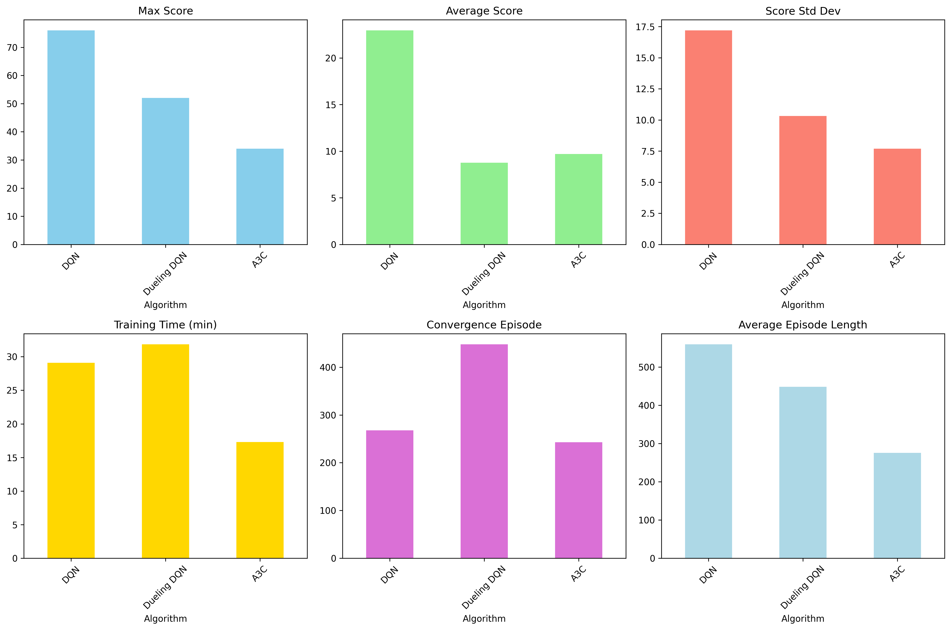
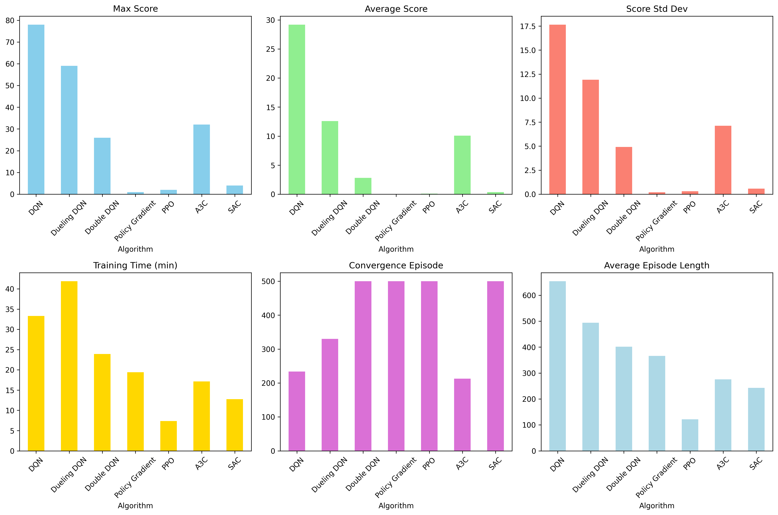

Slide 15
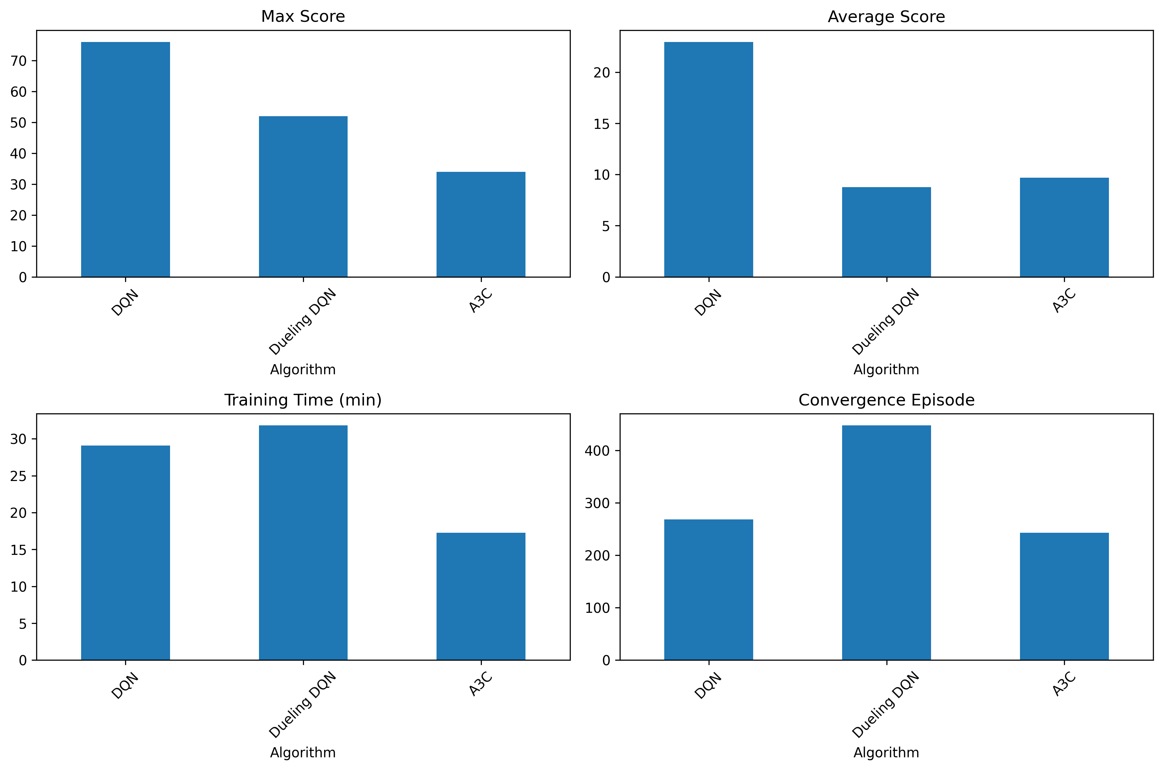

Slide 16
Conclusion:
Best Performing Algorithm: DQN
Highest Max Score (78) and Average Score (29.2)
Drawback: High Score Std Dev (17.65) → unstable
Most Balanced: A3C
Fastest convergence (213 episodes)
Moderate score (Avg: 10.06)
Efficient training (17.13 min)
Lower variance than DQN → more stable
Dueling DQN
Good Max Score (59) and improved stability (Std Dev: 11.92)
Poor Average Score and longest training time (41.88 min)

Slide 17
References:
[1] D. Ray, A. Ghosh, M. Ojha, and K. P. Singh, "Deep Q-Snake: An Intelligent Agent Mastering the Snake Game with Deep Reinforcement Learning," 2024 IEEE Region 10 Conference (TENCON), 2024, pp. 1465–1472, doi: 10.1109/TENCON61640.2024.10903025.
[2] A. del Rio, D. Jimenez, and J. Serrano, "Comparative Analysis of A3C and PPO Algorithms in Reinforcement Learning: A Survey on General Environments," IEEE Access, vol. 12, pp. 146795–146812, Oct. 2024, doi: 10.1109/ACCESS.2024.3472473.
[3] J. Wang, D. Xue, J. Zhao, W. Zhou, and H. Li, "Mastering the Game of 3v3 Snakes with Rule-Enhanced Multi-Agent Reinforcement Learning," 2022 IEEE Conference on Games (CoG), Beijing, China, pp. 229–236, Aug. 2022, doi: 10.1109/CoG51982.2022.9893608.
[4] https://github.com/patrickloeber/snake-ai-pytorch

